Slide 1
Sponsor Demo
Norbert Szücs
Pallida Cohort - Static Class

Slide 2

Before Green Fox Academy

Slide 3
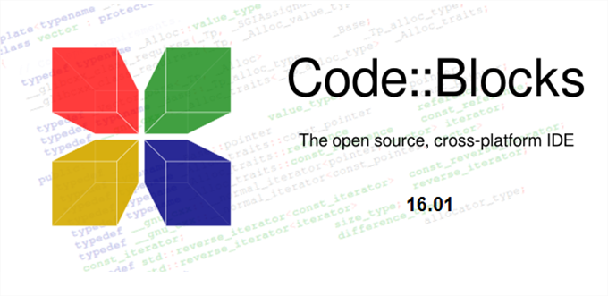
Early stage
Notes:
Introduction to CodeBlocks, along with C programming language where we learned the basics, what is a vaiable, data types, basic math operators, if statement, if else statement and so on. It was though and tiring.
Then we continued our way into the loops where we successfully accomplished the tasks like anagram, palindrome builder and searcher, and, my personal favourite, the josephus problem.

Slide 4
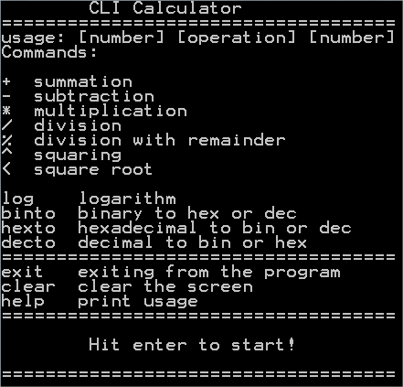
Early stage++
Notes:
Then we arrived to our first project, in the early stage++, which was the CLI calculator. It can do some basic math operations, like sum, subtract and also some advanced ones, like log, binary to hex. We needed to use all the knowledge we have gathered until this project.

Slide 5
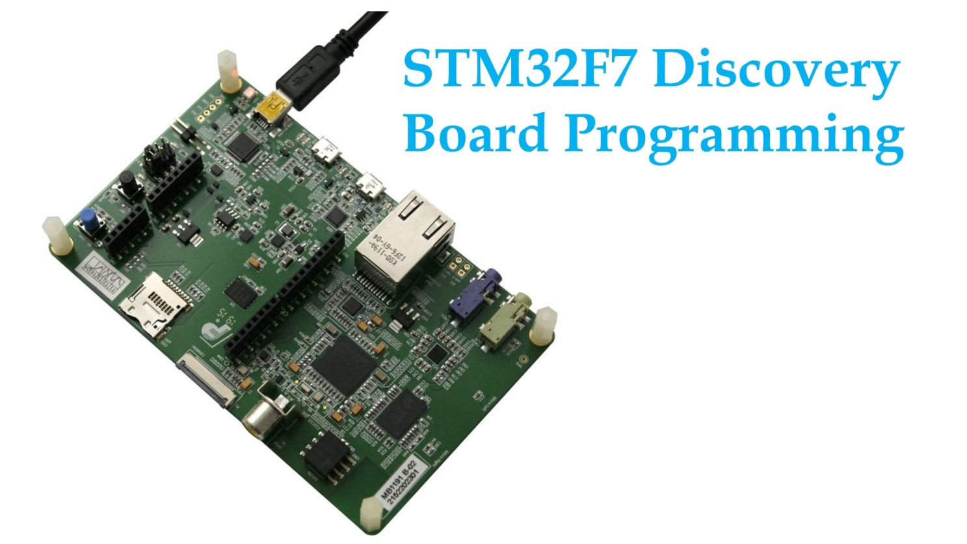
Orientation Stage
Notes:
And finally we have arrived to our actual studies, the real hardware programming. We are using the STM32F7 32 bit microcontroller. First we had to connect buttons and leds and resistors to the breadboard so we could set them and make the led lightning.

Slide 6
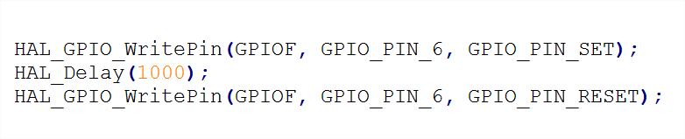
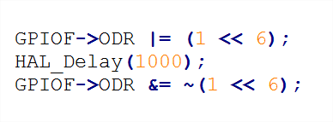
Orientation Stage++
Notes:
We are using the HAL (Hardware Abstration Layer) of the controller to achieve this. Just a simple example, how to lit the led in two ways. First, using HAL library and the second one using the ODR (Output Data Register) shifting the bits.

Slide 7
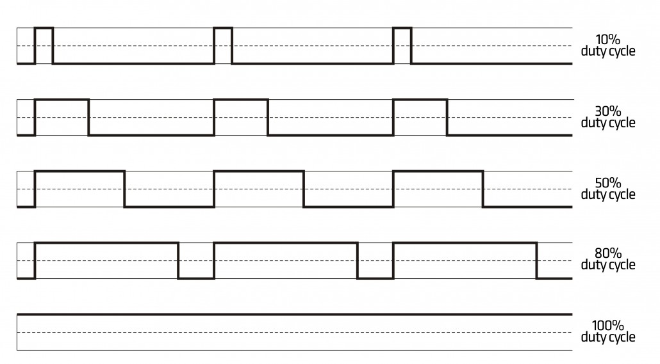
Orientation Stage++
Notes:
This week we have been introduced to some more challenging topics, Timers, PWM, and Interrupt. I will talk about the PWM. PWM is a magical and very interesting thing, it is short for Pulse-width modulation. In nutshell, it is a modulation technique for getting analog results with digital means. It has a very wide range of application, like telcom, servo motors, audio equipment and so on. The term duty cycle like in the figure, describes the proportion of on time to the regular interval or period of time. A low duty cycle means low power because the power is off most of the time. Duty cycle is expressed in percent, 100% means being fully on.

Slide 8
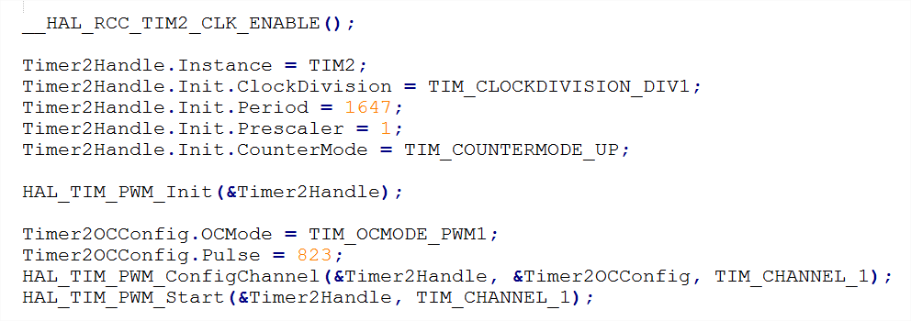
Orientation Stage++
Notes:
We have used PWM to dim a led, on 50% duty scale, meaning that it will blink very fast. In order to do this, we need to configure several things. We need to setup a structure, define the elements, setting up a period, a processor speed prescaler and the pulse.

Slide 9
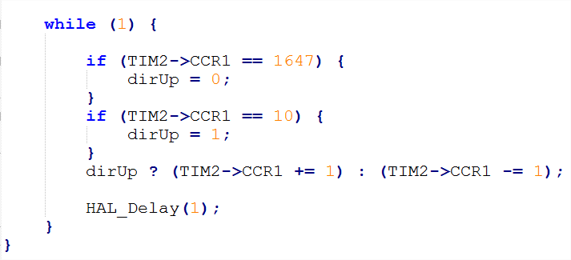
Orientation Stage++
Notes:
This is the main logic in the while loop where our led will be dimming between a period, with 50% duty scale.

Slide 10
Orientation Stage++
Notes:
And the result is something like this. I realized that with PWM and Interrupts we can do many many interesting projects, so Im looking for more challenges. The message of the day is that if you don’t fully understand something, dig yourself into it, all the information is within range of an arm!

Slide 11
Thank you for your attention!

